Slide 1
Azure Fundamentals part 2
Core architectural components of Azure

Slide 2
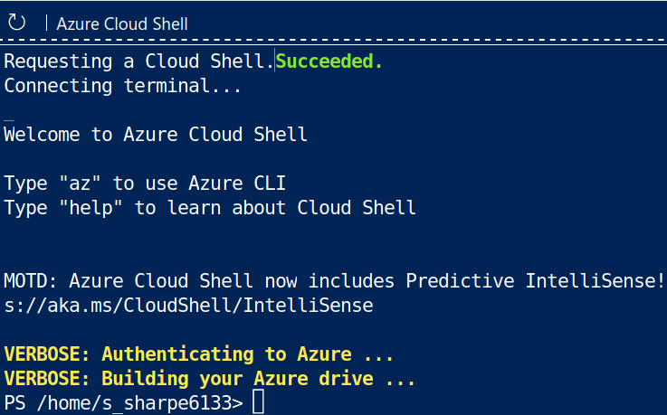
PowerShell CLI

Slide 3
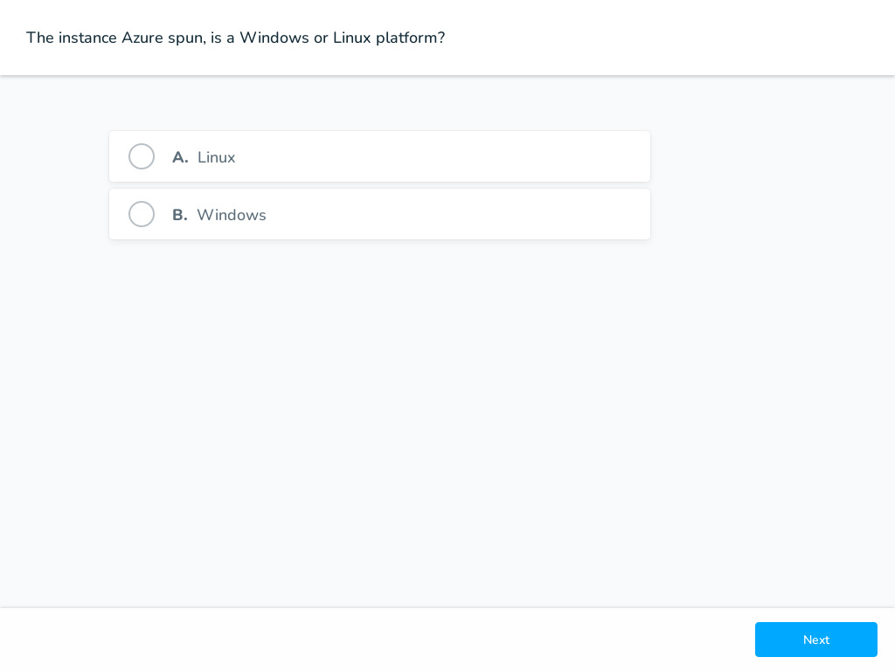
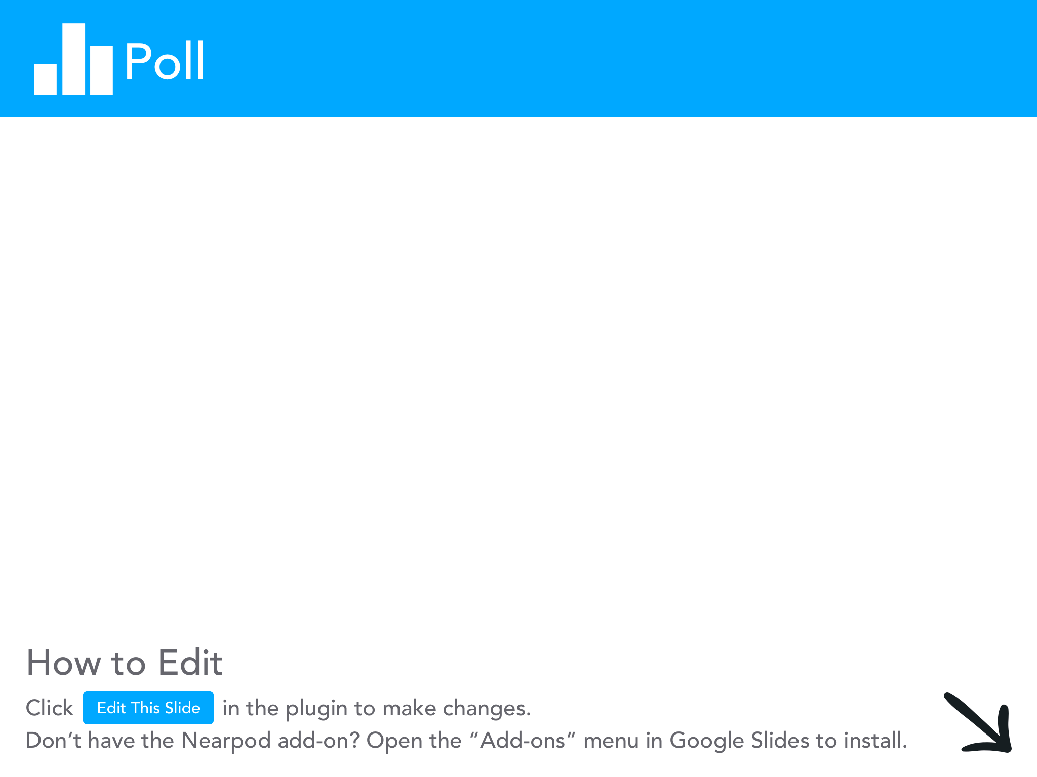

Slide 4
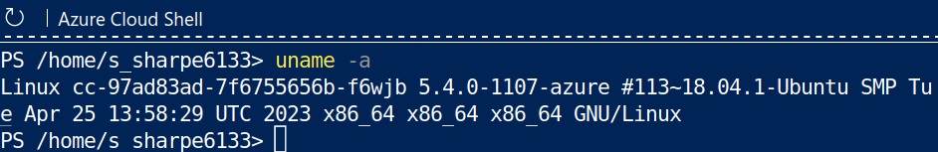
PowerShell for Linux

Slide 5
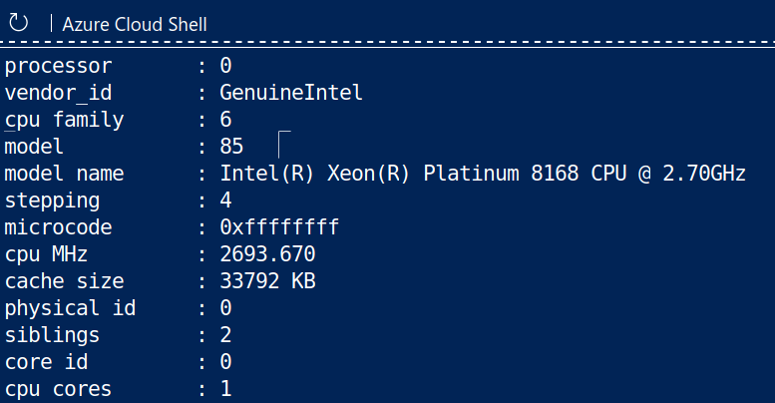
Cpuinfo - I was curious

Slide 6
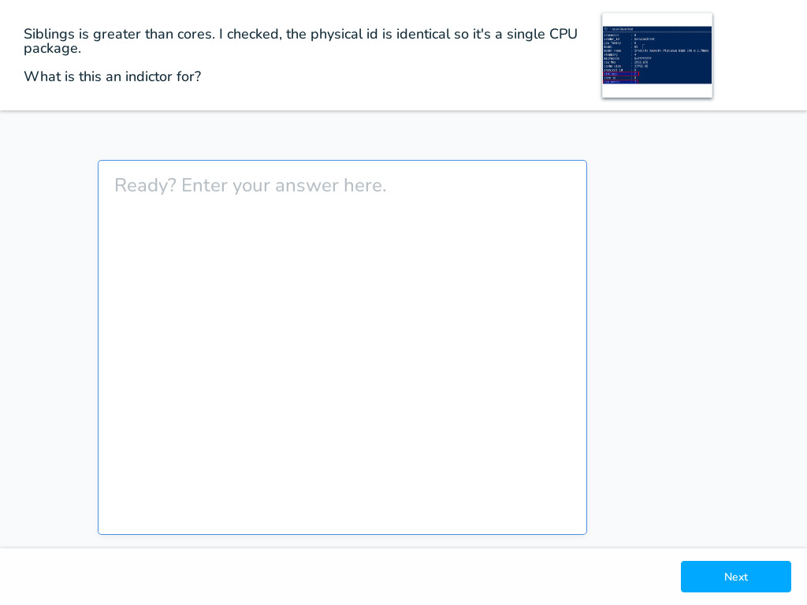
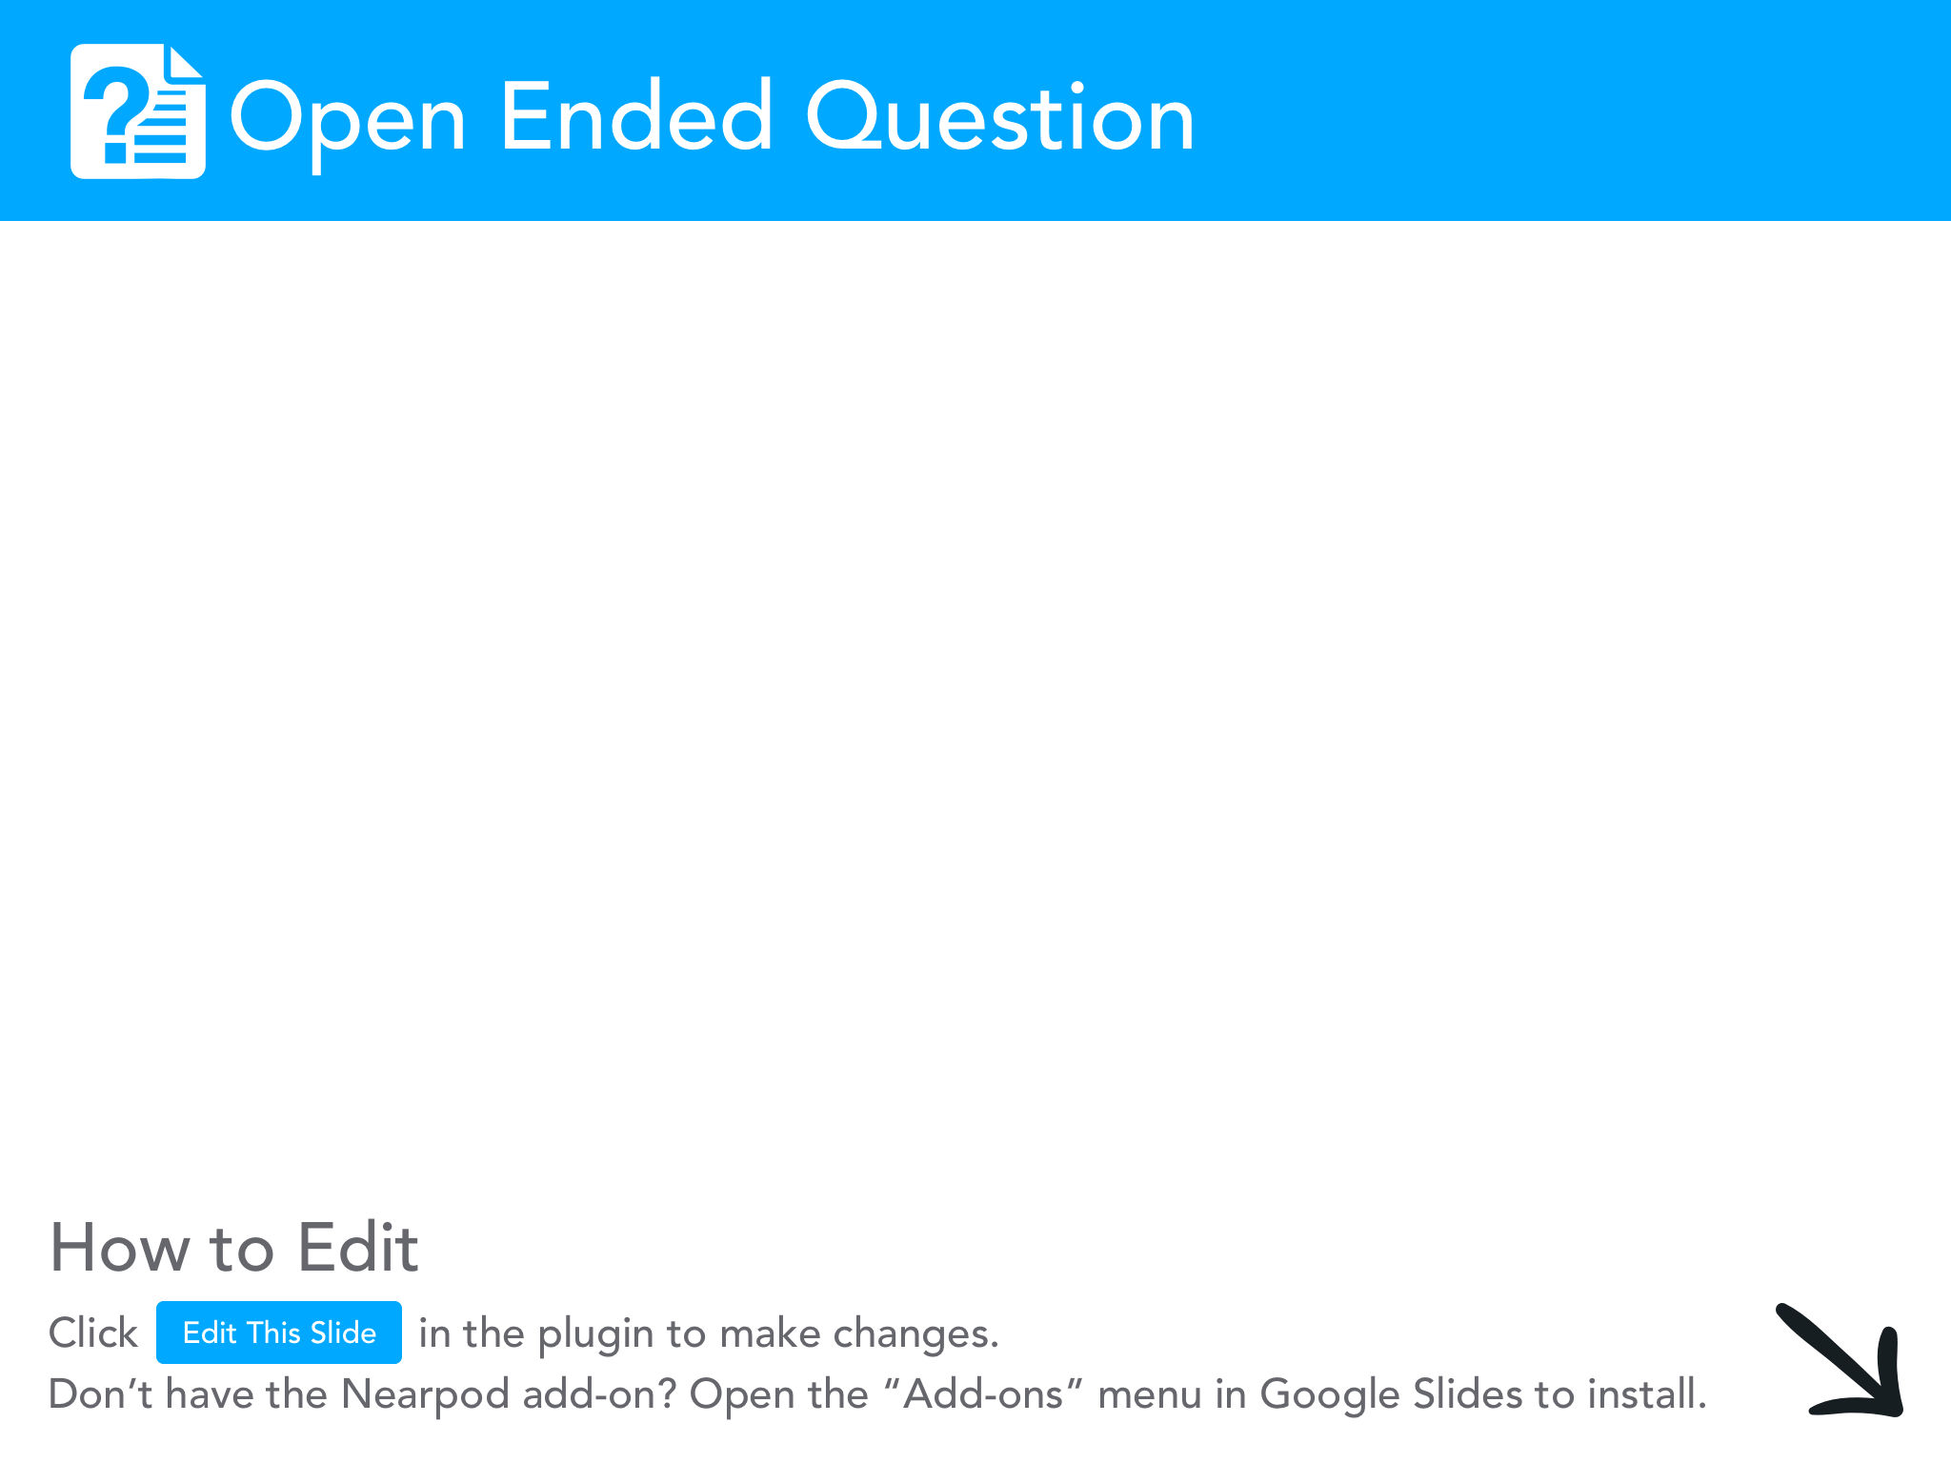

Slide 7
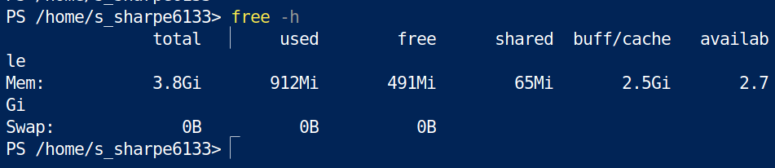
Memory - Curiosity continued

Slide 8
Shells
You can use the default PowerShell for Linux
Bash
Interative which is Intellisense on steroids

Slide 9
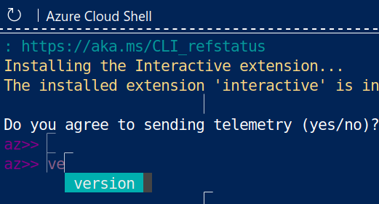
az interactive
Do not require
az command for
Azure specific commands

Slide 10
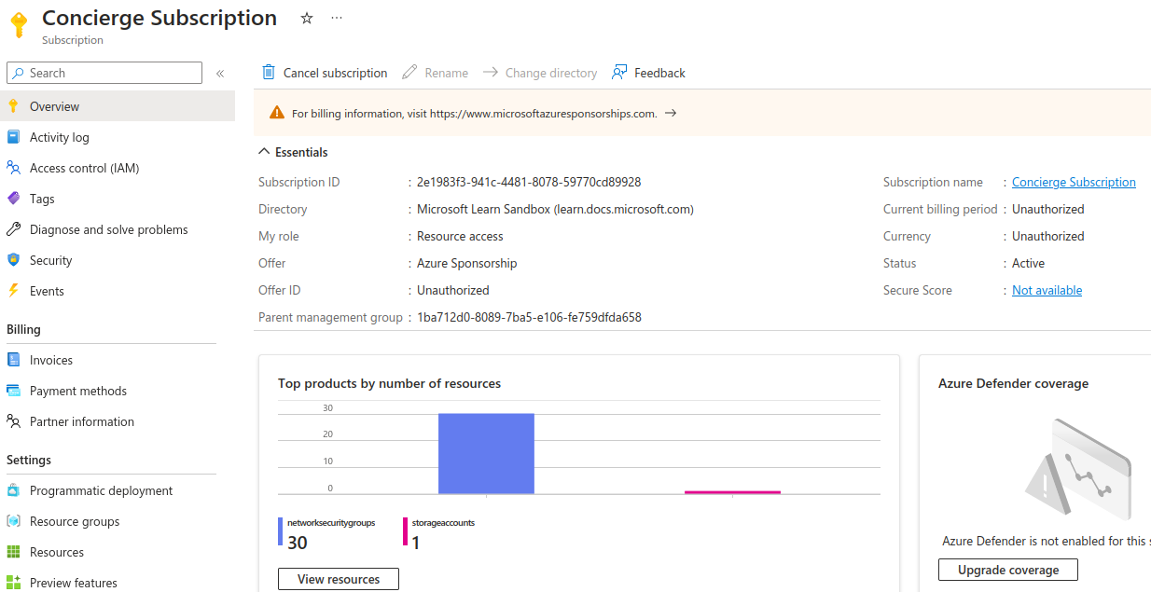
Learn subscription

Slide 11
Storage
Take ten minutes to figure out
1) The OS drive - what is the size?
2) What is the drive used for production files? Size? Filetype?

Slide 12
Sanbox URL
https://learn.microsoft.com/en-us/training/modules/describe-core-architectural-components-of-azure/4-exercise-explore-learn-sandbox

Slide 13
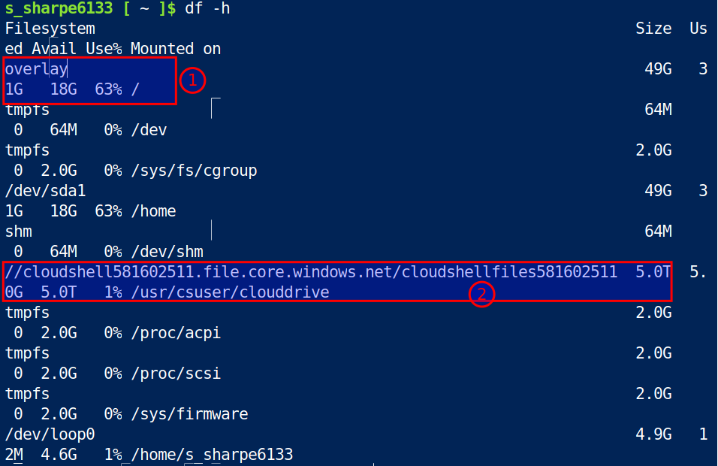
Root
Overlay filetype
Voodo magic
By Docker.

Slide 14
Clouddrive
Notice the
//
Look familiar?

Slide 15
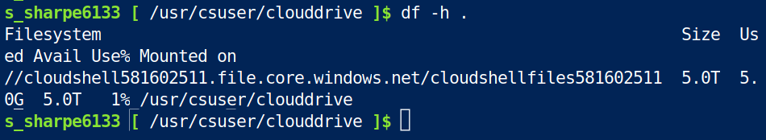
5TB Cloud Drive

Slide 16
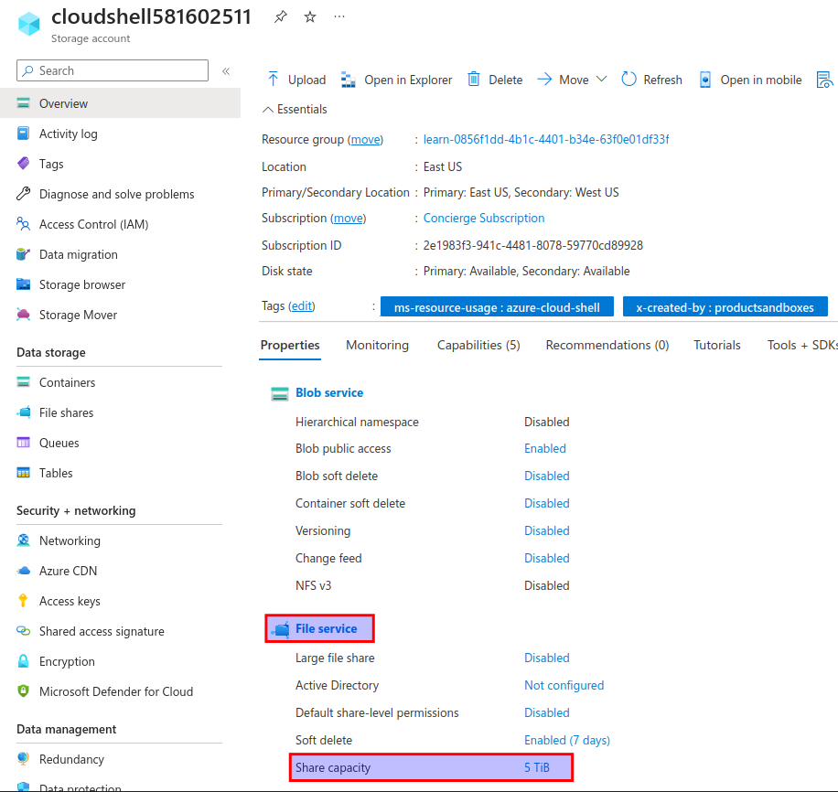
It’s a fileshare

Slide 17
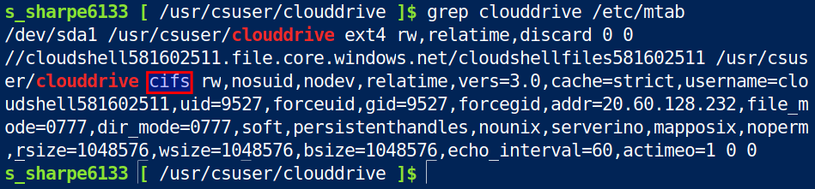
CIFS is the Windows File Sharing

Slide 18
fstab vs mtab
Just fyi
fstab you learned in Securing Linux was systems to be mounted on startup
mtab is everything is mounted.
Conclusion: everything on this environment was mounted after system startup by something.

Slide 19
Take a stroll around the globe
https://datacenters.microsoft.com/globe/explore

Slide 20
Regions
1) Set of datacenters deployed within a latency-defined perimeter
2) connected through a dedicated regional low-latency network.

Slide 21
Sovereign Regions
US Department of Defence: These regions are physical and logical network-isolated instances of Azure for U.S. government agencies and partners. These datacenters are operated by screened U.S. personnel and include additional compliance certifications.
Cina East, China North, and more: These regions are available through a unique partnership between Microsoft and 21Vianet, whereby Microsoft doesn't directly maintain the datacenters.

Slide 22
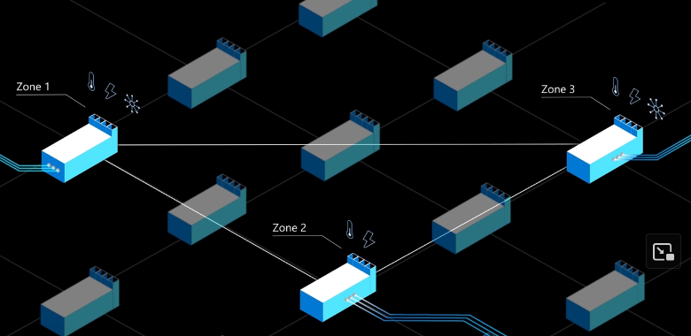
Availability zones
Connects at least three independent DCs with their own cooling, power and networking in the same region.

Slide 23
Availability zones
Will pay for data transfer between zones and the additional VMs in every zone

Slide 24
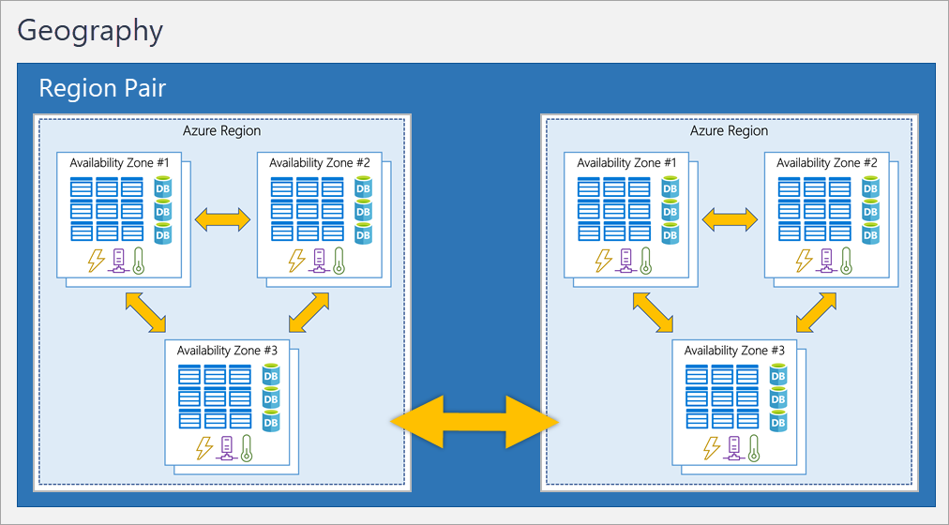
Region pairs
Availability zones can be replicated into region pairs

Slide 25
Azure Edge Zones
Get your application as close to the customer as possible.
Azure public MEC (multi-access edge compute) integrates Azure compute and services with mobile operator 5G connectivity for low-latency applications at the operator edge.

Slide 26
Geographies
An Azure geography is a distinct market, typically containing one or more regions.
Specific data residency (where data is stored and processed). Example would be Canada with medical records

Slide 27
Points-of-Presence (PoPs)
Customer is in New York, however our Azure service is in the West US region.
How is the data going to get there?

Slide 28
Points-of-Presence (PoPs)
Traditionally this would go through the public internet.
What about with PoPs?

Slide 29
Points-of-Presence (PoPs)
1) Customer will access the nearest Azure PoP
2) traffic will then use Microsoft’s backbone to reach West US’s DC

Slide 30
Points-of-Presence (PoPs)
You might pay for the data transferred from the PoP to your region.

Slide 31
Space - the final frontier?
You operate a constellation of satellites that capture high-resolution images of Earth's surface but want to store the footage in the cloud.

Slide 32
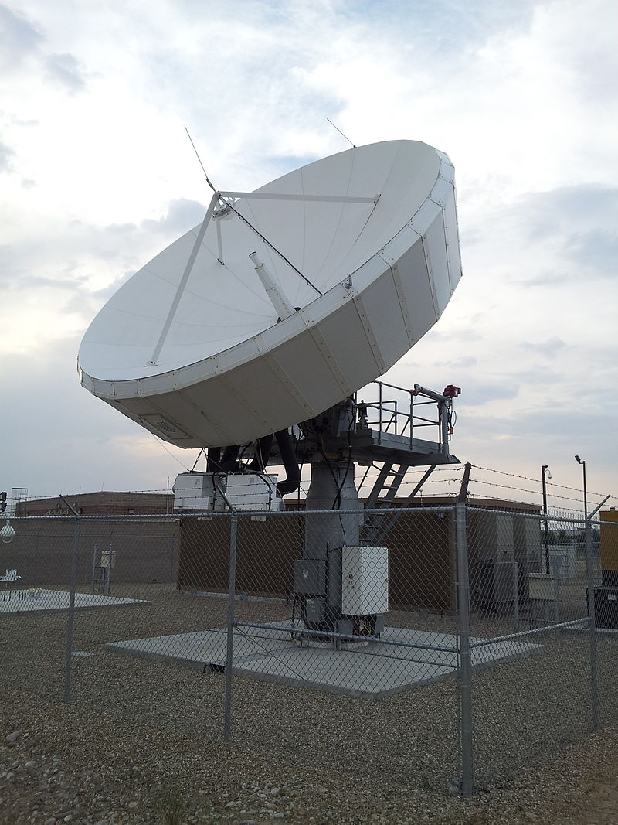
Space - the final frontier?
1) One or more ground stations

Slide 33
Space - the final frontier?
2) Download the imagery data

Slide 34
Space - the final frontier?
3) Process the data on-premises or upload to the cloud

Slide 35
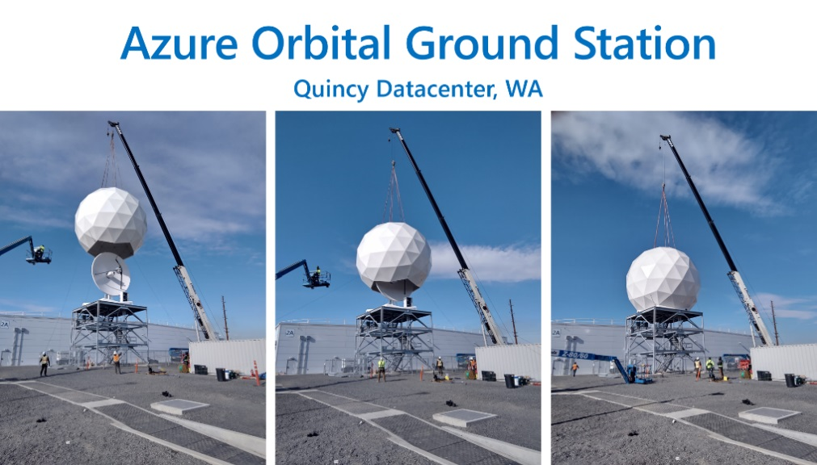
Space - Easy button
1) Microsoft's ground station as a service called Azure Orbital

Slide 36
Resource Groups examples
Group by:
1) Function such as temporary dev environment
2) Access schema
Flexible to designed in many ways

Slide 37
Accounts vs subscriptions
Accounts: You can only have one account
Subscriptions: You require one subscription but can have many.

Slide 38
Subscription boundary examples
Billing: Azure generates separate billing reports and invoices for each subscription
Access Control: Can create separate subscriptions to reflect different organizational structures.

Slide 39
Management groups
You have three subscriptions but a single governance strategy. How do you apply this equally to all three?
Nest three subscriptions into a single management group and apply the policy.

Slide 40
Management Group examples
Data Governance: Limit VM Location to Canada. The administrator of the subscription cannot override.
Role Based Access: Apply to the group, which is inherited by all subscriptions and resource groups.

Slide 41
Virtual Machines - scale sets
Virtual machine scale sets automate the management, configuration, and scaling of a group of identical, load-balanced VMs, simplifying large-scale deployments and ensuring efficient resource utilization.

Slide 42
Virtual Machines - availability sets
Update Domain: ensures minimal downtime during updates by grouping VMs for sequential updates
Fault Domain: enhances fault tolerance by spreading VMs across different power sources and network switches

Slide 43
VM Resources
Size (purpose, number of processor cores, and amount of RAM)
Storage disks (hard disk drives, solid state drives, etc.)
Networking (virtual network, public IP address, and port configuration)

Slide 44
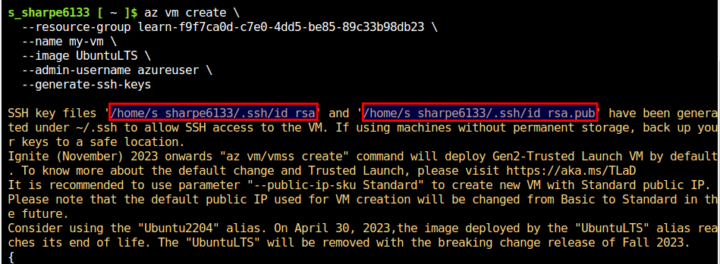
Manage your keys

Slide 45
Virtual Desktops
Cloud-hosted desktops and apps: Azure Virtual Desktop enables secure, remote access to Windows desktops and applications from any device or browser.
Enhanced security: Centralized security management with Azure AD, multifactor authentication, and granular RBACs, ensuring data protection and secure user access.

Slide 46
Virtual Desktops
Multi-session Windows 10/11: Offers a consistent user experience with support for multiple concurrent users on a single VM, and broader application compatibility.
Note: this is exclusively in the Windows 10 Enterprise edition for Azure Virtual Desktop deployments.

Slide 47
Virtual Desktops
Prior to Azure Virtual Desktop the closest solution was RDS on Windows Server.
1) Less familiar user experience
2) limited compatibility with certain applications designed for Windows client OS like Windows 10 & 11.

Slide 48
VMs vs Containers
Resource Efficiency: Containers are lightweight and share the host's OS kernel, which makes them faster to start and more resource-efficient than VMs, which have their own full OS.
Scalability: Containers are designed for agility and can be easily created, scaled out, or stopped dynamically, making them ideal for responding to changes in application demand quickly, while VMs are slower to scale.
Deployment and Isolation: VMs provide a full OS with strong isolation between instances, while containers offer process-level isolation, allowing for faster deployment and independent updates of application components.

Slide 49
Azure Functions
Event-driven and Serverless: Azure Functions is a serverless compute option that is triggered by events, allowing you to focus on your code without worrying about underlying infrastructure or resource provisioning.
Scalability and Cost-Effective: Azure Functions automatically scale based on demand and only charge for the CPU time used during execution, making them a cost-effective solution for variable workloads.

Slide 50
Azure Functions - stateful vs stateless
Stateless Functions: Ideal for short-lived, isolated tasks that do not require context from previous executions. Quick and efficient for single-purpose jobs like image processing or data validation.
Stateful Functions (Durable Functions): Designed for more complex workflows that need to maintain context and track prior activity, such as multi-step approval processes, long-running tasks, or coordinating multiple functions.
Flexible Design: Choose stateless for simplicity and speed, or stateful when context is required, enabling developers to build versatile serverless applications tailored to their specific needs.

Slide 51
Application hosting options
Azure App Service: A fully managed platform for building, deploying, and scaling web apps, APIs, and mobile backends.
Multiple Language Support: Build using .NET, .NET Core, Java, Ruby, Node.js, PHP, or Python.
Platform Choices: Supports both Windows and Linux hosting environments.
Seamless Deployment: Automated deployments from GitHub, Azure DevOps, or any Git repo for continuous integration and deployment.

Slide 52
Application hosting options
Types of App Services: Web apps, API apps, WebJobs, and Mobile apps.
Scalability & High Availability: Built-in load balancing, traffic manager, and easy scaling to handle traffic loads.
WebJobs: Run programs or scripts in the same context as a web app, triggered or scheduled, for background tasks.
Mobile Apps: Quickly build backends for iOS and Android apps, store data, authenticate users, send push notifications, and execute custom logic.

Slide 53
Virtual Networking - isolation
Private: Private address space accessible within Azure. Not publicly accessible
Public: Accessible by the internet (IPv4 or IPv6). Can also be the IP of a load balancer.

Slide 54
Virtual Networking - on-prem
Point-to-site: client machine on-prem makes a connection to the Azure network
Site-to-site: Azure devices appear as if they were on the local network
Azure ExpressRoute: dedicating link through

Slide 55
Virtual Networking - on-prem
Azure ExpressRoute: Through an ExpressRoute partner such as Verizon, AT&T, etc.
ExpressRoute supports four models
1) CloudExchange colocation, 2) Point-to-point Ethernet connection 3) Any-to-any connection,
4) Directly from ExpressRoute sites
Note: bypasses the public internet

Slide 56
Virtual Networking - Filter traffic
Network security groups: define rules for inbound/outbound
Network virtual appliances: firewall, WAN optimization

Slide 57
Virtual Networking - Custom routes
Custom route tables - by default Azure will determine the path.
But you have an Network Virtual Appliance (firewall) in the previous example, and want all traffic to pass through the NVA. You’ll require a custom route for this.

Slide 58
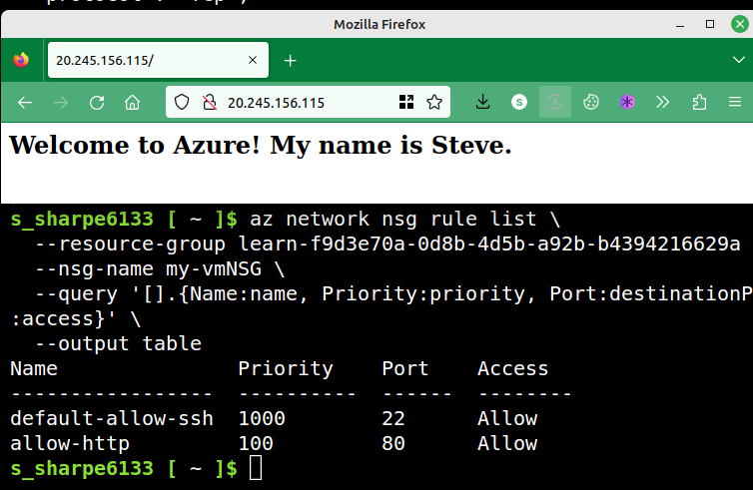
Configure Network Security Groups

Slide 59
Virtual Private Networks - Gateways
Policy-based VPN Gateway:
Uses static IP addresses for packet encryption
Suitable for simple, fixed network topologies
Manually define allowed subnets for secure communication

Slide 60
Virtual Private Networks - Gateways
Route-based VPN Gateway:
Supports dynamic routing protocols (e.g., BGP)
Adapts automatically to network topology changes
Enables traffic engineering and load balancing between multiple VPN tunnels

Slide 61
Virtual Private Networks - HA
Active/Standby: Default configuration, with two instances where the standby takes over during maintenance or disruptions; short connection interruptions.
Active/Active: Utilizes BGP routing protocol, assigns unique public IP addresses to each instance, and establishes separate tunnels to improve availability.
On-premises redundancy: Enhance high availability by deploying an additional VPN device on-premises for more resilient connections.

Slide 62
Virtual Private Networks - HA
ExpressRoute Failover: Configure a VPN gateway as a secure failover path for ExpressRoute connections to maintain connectivity during outages.
Built-in Resiliency: ExpressRoute circuits have built-in resiliency, but can still be affected by physical issues or complete location outages.
Zone-Redundant Gateways: In availability zone-supported regions, deploy VPN and ExpressRoute gateways in a zone-redundant configuration for enhanced resiliency and scalability.

Slide 63
Azure DNS - Security
Azure role-based access control (Azure RBAC)
Activity logs to monitor how a user in your organization modified a resource or to find an error when troubleshooting.
Resource locking to lock a subscription, resource group, or resource. Locking prevents other users in your organization from accidentally deleting or modifying critical resources.

Slide 64
Storage accounts - namespace
Storage account name must be unique within Azure. Consists of the account name and the Azure Storage service endpoint.
Next slide gives examples of Storage service endpoints.

Slide 65
Storage Service
1) Blob Storage: Storing large amounts of unstructured data, such as images, videos, or documents.
2) Data Lake Storage Gen2: Analyzing and processing big data workloads in a data lake environment.
3) Azure Files: Creating a shared network file system that can be accessed by multiple VMs or applications.
4) Queue Storage: Managing a queue of messages for asynchronous processing between different application components.
5) Table Storage: Storing large amounts of structured, non-relational data in a NoSQL table format, such as user metadata or application settings.

Slide 66
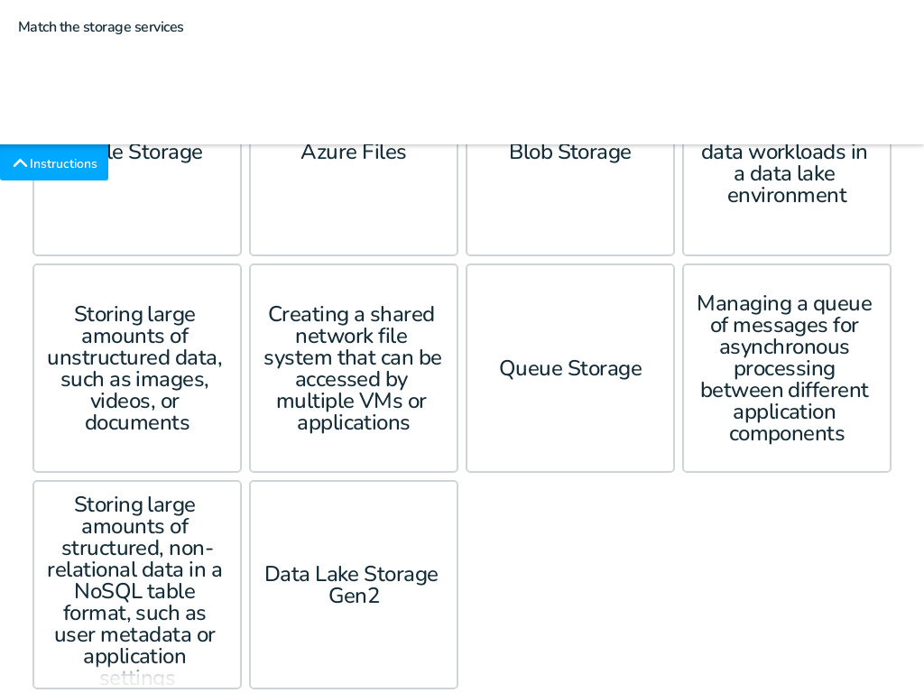
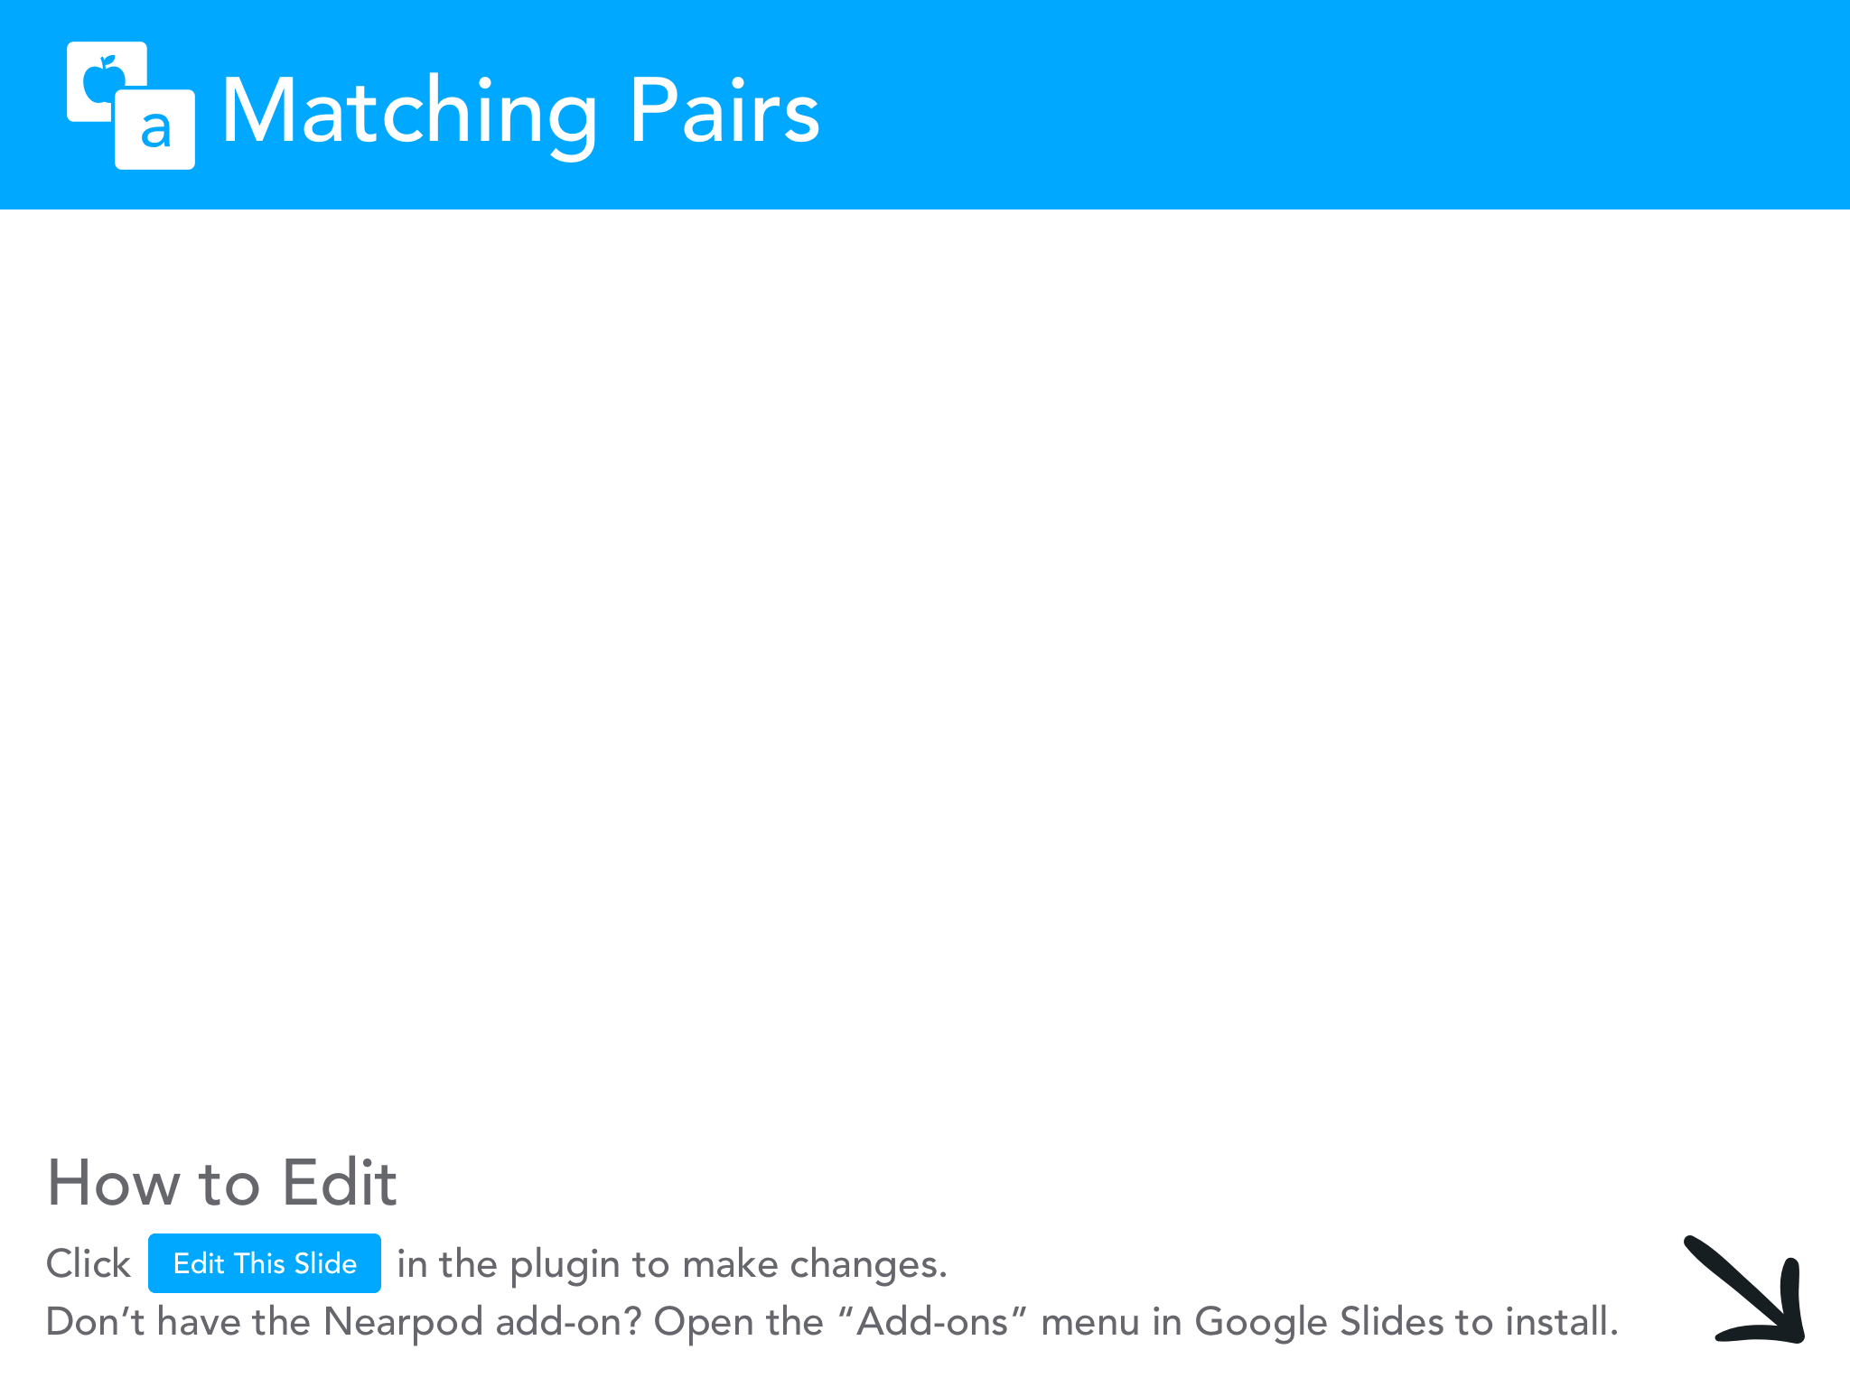

Slide 67
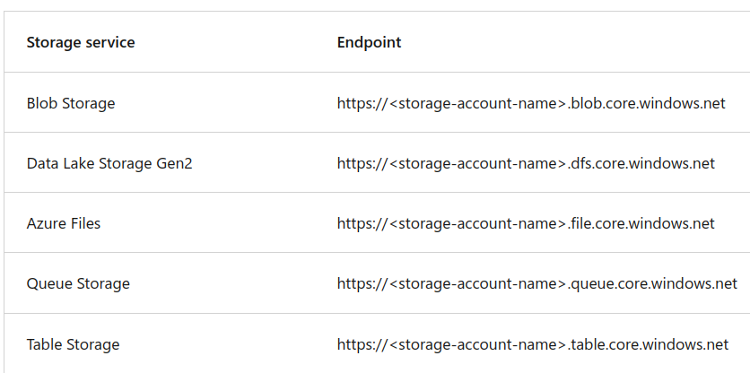
Storage accounts - endpoints

Slide 68
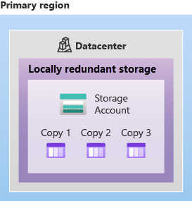
Storage redundancy - Primary region
1) Locally Redundant Storage (LRS): Replicates data three times within a single data center in the primary region.
2) LRS Durability: Provides at least 11 nines of durability (99.999999999%) of objects over a given year.

Slide 69
Storage redundancy - Primary region
3) LRS Protection: Guards against server rack and drive failures but doesn't protect against data center disasters.
4) Alternative Options: To mitigate data center disaster risks, consider using Zone-Redundant Storage (ZRS), Geo-Redundant Storage (GRS), or Geo-Zone-Redundant Storage (GZRS).

Slide 70
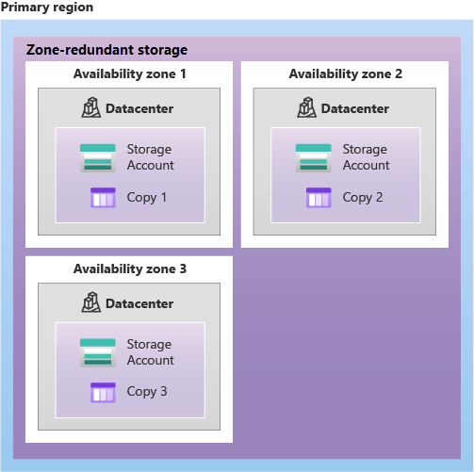
Zone-redundant storage
1) Zone-Redundant Storage (ZRS): Replicates data synchronously across three Azure availability zones in the primary region.
2) ZRS Durability: Offers at least 12 nines of durability (99.9999999999%) for Azure Storage data objects over a given year.

Slide 71
Zone-redundant storage
3) High Availability: ZRS ensures data remains accessible for both read and write operations even if one zone becomes unavailable.
4) Data Governance: Ideal for scenarios that require high availability or need to restrict data replication within a country or region to comply with data governance requirements.

Slide 72
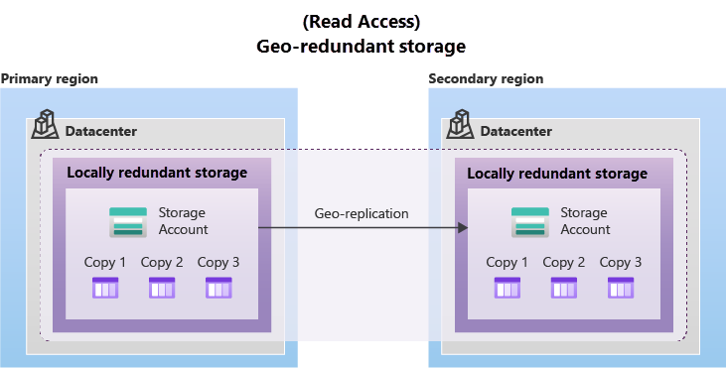
Geo-redundant storage
1) GRS Overview: Combines synchronous LRS replication in the primary region with asynchronous LRS replication in the secondary region.
2) Enhanced Durability: Provides a 99.99999999999999% durability for Azure Storage data objects over a given year.

Slide 73
Redundancy in a secondary region
1) Secondary Region Redundancy: Enhances data durability by copying data to a secondary region, hundreds of miles away from the primary region.
2) Two Options: Geo-redundant storage (GRS) for LRS-like redundancy in both regions, and geo-zone-redundant storage (GZRS) for ZRS-like redundancy in the primary region and LRS in the secondary region.
3) Failover Capability: In case of primary region unavailability, you can choose to fail over to the secondary region, making it the new primary region for read and write access.
4) Recovery Point Objective (RPO): Represents the possible data loss in case of primary region failure, typically less than 15 minutes for Azure Storage, although there's no SLA for replication time to the secondary region.

Slide 74
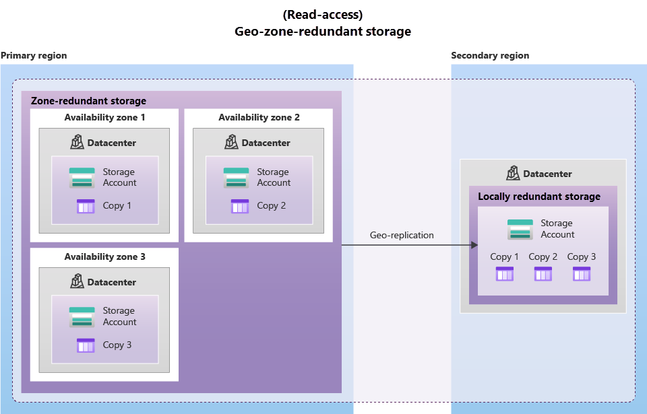
Geo-zone-redundant storage
1) GZRS Overview: Combines the high availability of ZRS (across three availability zones in primary region) with LRS in the secondary region.
2) Regional Disaster Protection: Ensures data safety even during regional outages by replicating data to a secondary geographic region.

Slide 75
Geo-zone-redundant storage
3) Maximum Consistency and Availability: Ideal for applications requiring excellent performance, resilience, and disaster recovery.
4) Enhanced Durability: Provides 99.99999999999999% durability of objects over a given year for maximum data safety.

Slide 76
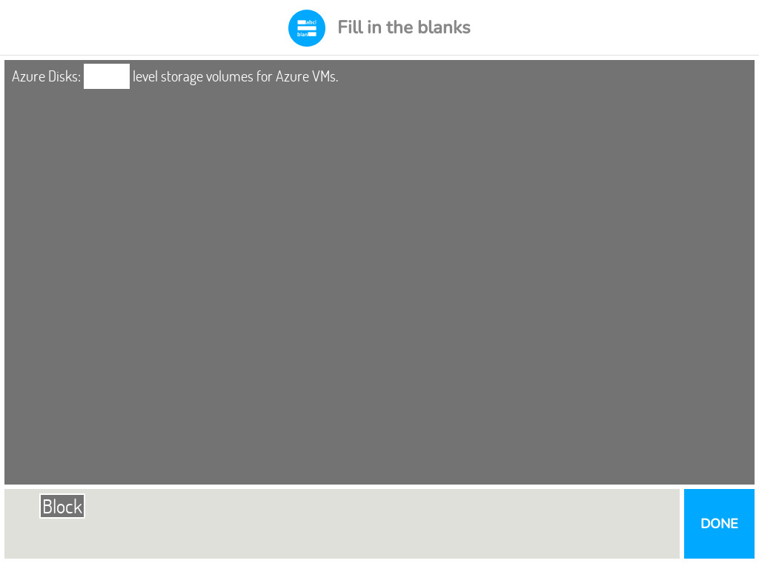


Slide 77
Blob storage tiers
1) Hot Access Tier: Optimized for frequently accessed data, such as website images.
2) Cool Access Tier: Ideal for infrequently accessed data stored for at least 30 days, like customer invoices.
3) Archive Access Tier: Suitable for rarely accessed data stored for at least 180 days, such as long-term backups.
4) Access Tier Considerations: Choose the appropriate tier based on data usage patterns, balancing availability, durability, retrieval latency, and storage costs.

Slide 78
Azure Files
1) Shared Access: Azure Files supports SMB and NFS protocols, enabling seamless integration with existing on-premises file shares.
2) Fully Managed: No need to manage hardware or OS, allowing for hands-off maintenance and improved security.
3) Scripting & Tooling: Use PowerShell cmdlets, Azure CLI, Azure portal, and Azure Storage Explorer to easily create, mount, and manage Azure file shares.
4) Resiliency & Familiar Programmability: Built for high availability, with familiar file system I/O APIs, making migration of existing applications straightforward.

Slide 79
Queue Storage
Scalable Message Storage: Queue Storage allows storing large numbers of messages with the capacity to handle potentially millions, making it suitable for asynchronous work backlogs.
Integration with Azure Functions: Easily trigger actions when messages are received, streamlining processes such as responding to customer form submissions.

Slide 80
Disk Storage
Simplified Management: Azure managed disks provide block-level storage volumes with automated management, reducing the effort needed for provisioning and maintenance.
Enhanced Resiliency & Availability: Virtualization of disk storage ensures greater resiliency and availability compared to physical disks, improving performance and reliability.

Slide 81
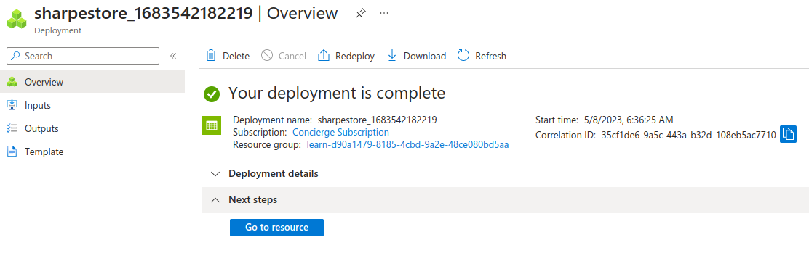
Blob Storage account

Slide 82
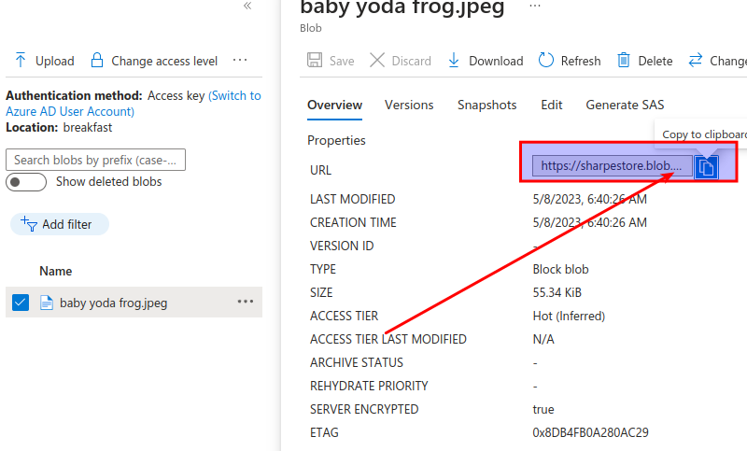
Blob Storage account

Slide 83
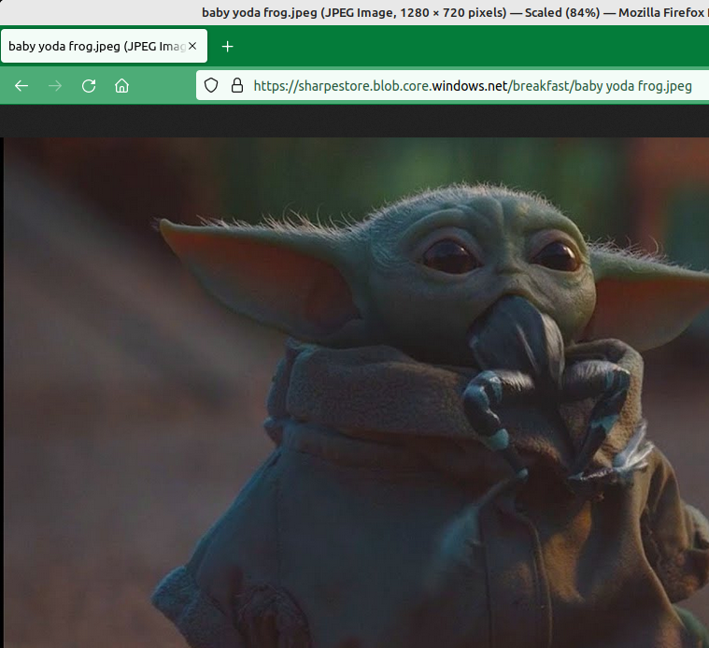
Blob Storage account

Slide 84
Migration options - Azure data box
1) Fast & Reliable Data Transfer: Azure Data Box provides a secure and efficient physical migration service for transferring large volumes of data to or from Azure.
2) End-to-End Tracking: The Data Box service in the Azure portal allows for easy monitoring of the entire data migration process, from shipping to data uploading.

Slide 85
file movement options - Azure file sync
Centralized File Shares: Azure File Sync allows you to centralize your file shares in Azure Files while maintaining the flexibility and performance of a local Windows file server.
Global Caching & Cloud Tiering: Supports multiple caches worldwide, seamless data access through various protocols, and optimizes storage by keeping frequently accessed files local and infrequently accessed files in the cloud.

Slide 86
Azure directory services vs AD
Similarities with on-prem Active Directory:
Familiar Structure: Both Azure AD and on-premises Active Directory provide identity and access management services with a familiar structure for managing users, groups, and devices.
Integration: Azure AD can be integrated with on-premises Active Directory deployments, allowing seamless management and synchronization of users and groups.

Slide 87
Azure directory services vs AD
Differences with on-prem Active Directory:
Cloud-based Service: Azure AD is a cloud-based service managed by Microsoft, providing global availability, while on-premises Active Directory is managed by your organization.
Enhanced Security: Azure AD offers advanced security features like suspicious sign-in attempt detection and monitoring, which are not available with on-premises Active Directory.

Slide 88
Azure AD Connect
Seamless Integration: Connect on-premises AD with Azure AD using Azure AD Connect for a consistent identity experience between cloud and on-premises environments.
Synchronized Features: Azure AD Connect enables synchronization of user identities, allowing you to leverage features like SSO, multifactor authentication, and self-service password reset across both systems.

Slide 89
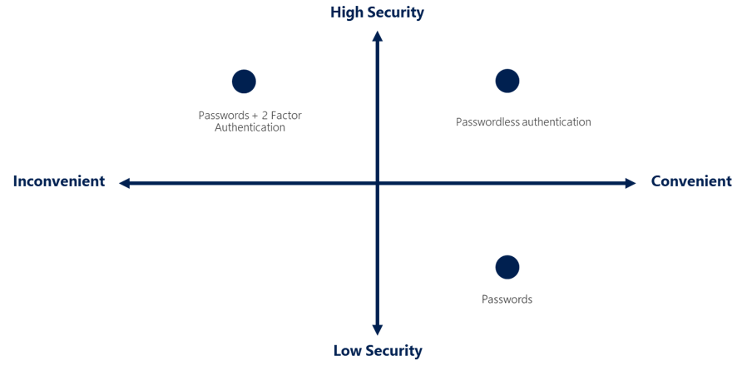
Authentication Methods

Slide 90
Passwordless Authentication
Enhanced Security and Convenience: Passwordless authentication replaces passwords with a combination of something you have, something you are, or something you know, making it more secure and user-friendly.
Device Setup: Passwordless authentication requires a registered or enrolled device, allowing Azure to associate it with the user for secure access.
Multiple Options: Azure AD integrates with Windows Hello for Business, Microsoft Authenticator app, and FIDO2 security keys to provide a range of passwordless authentication choices for organizations.

Slide 91
Microsoft Authenticator App
Biometric or PIN Verification: To authenticate, users receive a notification on their phone, match the displayed number on their device with the one on the screen, and confirm using biometric (touch or face) or PIN verification.

Slide 92
Azure external identities
1) External Identities: Azure AD External Identities enables secure interactions with users outside your organization, accommodating collaboration with partners, suppliers, or managing customer identity experiences.
2) Bring Your Own Identity: External users can sign in with their existing corporate, government-issued, or social credentials, such as Google or Facebook, maintaining control over their identity while accessing your resources.
3) B2B Collaboration: Azure AD allows external users to sign in to Microsoft and enterprise applications with their preferred identity. B2B direct connect establishes a mutual trust for seamless collaboration.
4) Azure AD B2C: For customer-facing apps, use Azure AD B2C for identity and access management, enabling the publication of modern SaaS or custom-developed apps.

Slide 93
Azure Conditional Access
1) Conditional Access: Azure Active Directory tool that grants or denies access to resources based on identity signals, including user, location, and device.
2) Empowering Users and Protecting Assets: Helps users maintain productivity while safeguarding the organization's resources through flexible access control.
3) Granular MFA Experience: Adjusts multifactor authentication challenges depending on user's location and behavior, enhancing security and user experience.
4) Signal-based Decisions and Enforcement: Conditional Access collects identity signals, makes decisions, and enforces access policies, such as requiring MFA or blocking access from high-risk locations.

Slide 94
Role Based Access Control
1) Azure RBAC: Azure role-based access control (RBAC) helps manage permissions for individuals or groups, adhering to the principle of least privilege.
2) Built-in and Custom Roles: Azure offers built-in roles describing common access rules, and you can also define your own roles for more specific access requirements.
3) Scopes: RBAC is applied to a scope, which could be a management group, subscription, resource group, or a single resource, determining the access level of assigned individuals/groups.
4) Hierarchical Permissions: RBAC uses a hierarchical model, allowing permissions granted at a parent scope to be inherited by all child scopes.
5) Azure RBAC Enforcement: Access permissions are enforced through Azure Resource Manager, which manages cloud resources and handles resource-level access but not application or data-level security.

Slide 95
Zero Trust Model
1) Assume Breach: The Zero Trust model operates under the assumption that a breach has occurred and verifies each request as though it originated from an uncontrolled network.
2) Guiding Principles: Verify explicitly, use least privilege access, and assume breach. This involves authenticating and authorizing based on all data points, limiting user access, and minimizing the blast radius.
3) Adaptation to Modern Environment: The Zero Trust model adapts to modern computing environments, securing mobile workforces, devices, applications, and data regardless of their location.
4) Zero Trust vs. Traditional Security: Unlike traditional security models that rely on location and trust within the corporate network, Zero Trust requires authentication and grants access based on that authentication rather than location.
5) Embracing Change: The Zero Trust model promotes increased security through continuous authentication, adapting to complex environments and better protecting resources across an organization.

Slide 96
Defense-in-depth
Defense-in-depth is a security strategy that employs a series of mechanisms to protect information and prevent unauthorized access to data. The concept is based on multiple layers of protection, ensuring that even if one layer is breached, the subsequent layers continue to protect the data. This approach removes reliance on any single layer of protection, slowing down attacks and providing valuable alert information for security teams to act upon.

Slide 97
The layers of defense-in-depth include
Physical security: Protects access to buildings and computing hardware in the datacenter.
Identity and access: Secures identities, grants access only when needed, and logs sign-in events and changes.
Perimeter: Protects from network-based attacks using tools like DDoS protection and perimeter firewalls.
Network: Limits network connectivity across resources to allow only what's required, minimizing the risk of an attack spreading to other systems.
Compute: Ensures compute resources are secure, with proper controls in place to minimize security issues.
Application: Integrates security into the application development lifecycle to reduce vulnerabilities in code.
Data: Controls access to data and ensures its confidentiality, integrity, and availability.
Azure provides security tools and features at every level of the defense-in-depth concept, helping organizations create a robust and secure infrastructure.

Slide 98
Windows Defender
The tool focuses on three main functions to help manage the security of your resources and workloads:
Continuously assess: Identify and track vulnerabilities through regular, detailed vulnerability scans covering your compute, data, and infrastructure.
Secure: Harden resources and services using Azure Security Benchmark and monitor new resources to ensure they are configured according to security best practices.
Defend: Detect and resolve threats to resources, workloads, and services through security alerts and advanced threat protection features.

Slide 99
Homework
https://learn.microsoft.com/en-us/training/paths/azure-fundamentals-describe-azure-architecture-services/
Link on the course site
Microsoft Azure Fundamentals: Describe Azure architecture and services

Slide 100
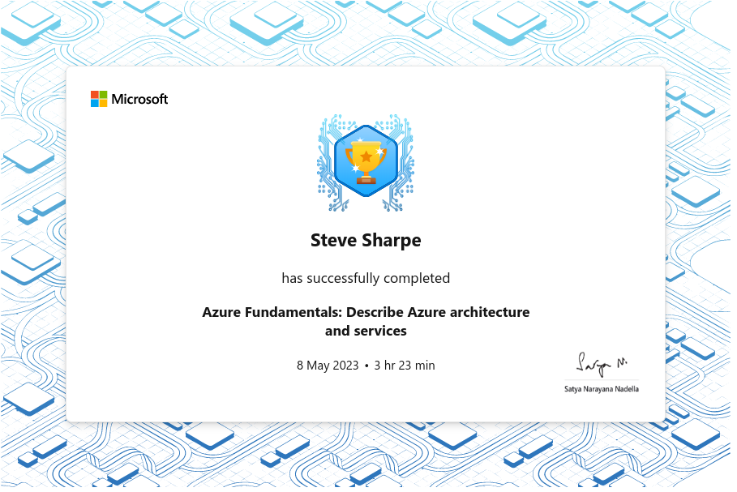
Slide 2

